Slide 1
Week 1 (2) – Introduction to Algorithms
CST370 – Design & Analysis of Algorithms
Computer Science

Slide 2
Lecture Objectives
After completion of this lecture, you will be able to
  explain the definition of algorithm.
  determine the greatest common divisor (gcd) using three different approaches.
  introduce a sieve of the Eratosthenes algorithm to generate prime numbers.

Slide 3
Chapter 1: Introduction
1.1 What is an Algorithm?
1.2 Fundamentals of Algorithmic Problem Solving
1.3 Important Problem Types
1.4 Fundamental Data Structures

Slide 4
<<< Course Instruction >>>
Before proceeding to the next slide, read from the page 1 through the page 7 of our textbook.
  Even if you don't understand some parts of the textbook, read it first.
  After that, go to the next slide.

Slide 5
What is an algorithm?
An algorithm is a sequence of unambiguous instructions for solving a problem, i.e., for obtaining a required output for any legitimate input in a finite amount of time.

Slide 6
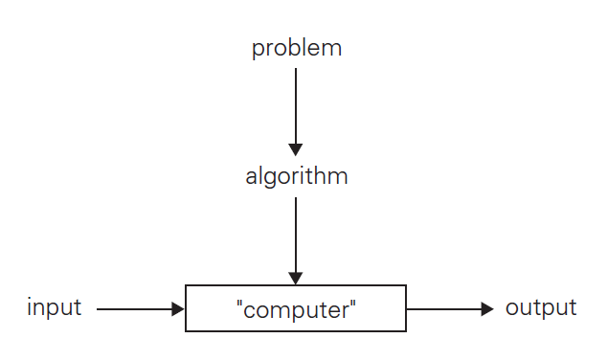
The Notion of Algorithm

Slide 7
Problem – GCD Calculation
The greatest common divisor of two nonnegative, not-both-zero integers m and n, denoted gcd(m, n), is defined as the largest integer that divides both m and n evenly, i.e., with a remainder of zero.
  In the description, note that input values, m and n, can’t be zero at the same time.

Slide 8
Example
Calculate the gcd for the following four cases with a pencil and paper.
    // Do not move directly to the next slide.
    // First, solve this problem yourself.
    // Then, compare your answer with the solution
    // on the next slide.
  gcd(6, 4) = ?
  gcd(60,24) = ?
  gcd(60,0) = ?
  gcd(0,0) = ?

Slide 9
Example – Solution
gcd(6, 4) = 2
gcd(60,24) = 12
gcd(60,0) = 60
// Note that if one of two values n and m is 0,
// another non-zero input value is the answer
// to the gcd problem.
gcd(0,0) = Invalid input
// By definition, both input values n and m
// can’t be zeroes in the gcd problem.

Slide 10
Euclid’s Algorithm
Euclid’s algorithm is based on repeated application of equality
gcd(m, n) = gcd(n, m mod n)
until the second number becomes 0, which makes the first number become the answer.

Slide 11
Euclid’s Algorithm – Example 1
gcd(60, 24)
= gcd(24, 12) // “60 mod 24” is 12.
= gcd(12, 0) // “24 mod 12” is 0.
= 12

Slide 12
Euclid’s Algorithm – Example 2
gcd (4, 6)
= gcd(6, 4) // Note that “4 mod 6” is 4.
= gcd(4, 2)
= gcd(2,0)
= 2

Slide 13
Exercise
Calculate the gcd (40, 56) using the Euclid’s algorithm.
  // Do not move directly to the next slide.
  // First, solve this problem yourself.
  // Then, compare your answer with the solution
  // on the next slide.

Slide 14
Exercise – Solution
gcd (40, 56)
= gcd(56, 40)
= gcd(40, 16)
= gcd(16,8)
= gcd(8,0)
= 8

Slide 15
More Structured Description of Euclid’s Algorithm
Euclid’s algorithm for computing gcd(m, n)
  Step 1 If n = 0, return m and stop; otherwise go to Step 2
  Step 2 Divide m by n and assign the value for the remainder to r
  Step 3 Assign the value of n to m and the value of r to n. Go to Step 1.

Slide 16
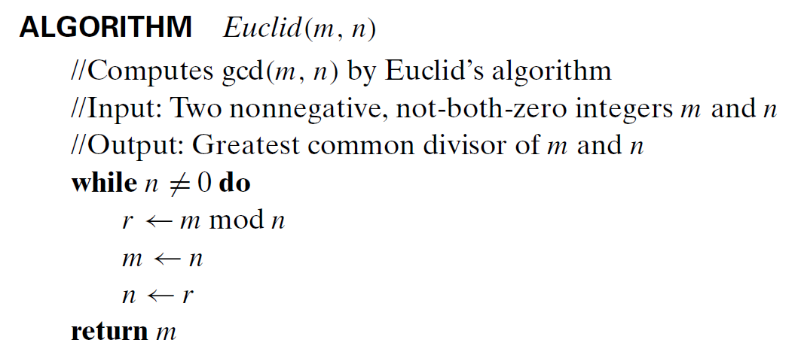
Alternative description – Pseudocode

Slide 17
Pseudocode (1 of 2)
Pseudocode is an informal high-level description of an algorithm.
  It uses the structural conventions of a normal programming language, but is intended for human reading rather than machine reading.
  Pseudocode typically omits details that are essential for machine understanding of the algorithm, such as variable declarations.
No standard for pseudocode syntax exists.
  In the class, we will try to follow the pseudocode convention in our textbook.

Slide 18
Pseudocode (2 of 2)
The pseudocode in the textbook does not contain error handling used in the actual programming implementation.
  Therefore, you should assume that the algorithms described in the textbook work only on the appropriate inputs.

Slide 19
<<< Course Instruction >>>
Read the following document to get the basic pseudocode notation of our textbook.
  https://goo.gl/H88yR1

Slide 20
Two Other Methods to Calculate GCD
Euclid’s algorithm works well to find gcd.
However, there exist several other approaches to compute the gcd.

Slide 21
Consecutive integer checking algorithm for computing gcd (m, n)
Step 1 Assign the value of min{m,n} to t
Step 2 Divide m by t. If the remainder is 0, go to Step 3; otherwise, go to Step 4
Step 3 Divide n by t. If the remainder is 0, return t and stop;otherwise, go to Step 4
Step 4 Decrease t by 1 and go to Step 2

Slide 22
Middle-school procedure for computing gcd (m, n)
Step 1 Find the prime factorization of m
Step 2 Find the prime factorization of n
Step 3 Find all the common prime factors
Step 4 Compute the product of all the common prime factors and return it as gcd(m,n)

Slide 23
Middle-school procedure – Example
gcd (60, 24)
  60 = 2 X 2 X 3 X 5
  24 = 2 X 2 X 2 X 3
  gcd(60, 24) = 2 X 2 X 3 = 12.
Is this an algorithm?
  No because the prime factorization is not unambiguous.
  Furthermore, this approach is more complex and slower than Ecuclid’s algorithm.

Slide 24
Some Important Points for Algorithms
Input has to be specified carefully.
The same algorithm can be represented in several different ways.
Several algorithms for solving the same problem may exist.
Algorithms for the same problem can be based on very different ideas and can solve the problem with dramatically different speeds.

Slide 25
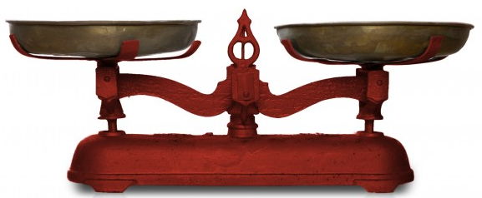
Algorithmic Puzzle:
Find a fake coin among eight coins
There are eight identical-looking coins; one of these coins is counterfeit and is known to be lighter than the genuine coins.
What is the minimum number of weighings needed to identify the fake coin with a two-pan balance scale without weights like below?

Slide 26
Important Note
Do not see the answer immediately on the next page.
  If you do, you will not get any knowledge from this puzzle.
Hint: If your answer is three measurements, you have good computer science knowledge.
  However, you can identify the fake coin through only two measurements. How can you do this?

Slide 27
Solution
Select from the given coins two groups of three coins each and put them on the opposite cups of the scale.
  If they weigh the same, the fake is among the other two coins, and weighing these two coins will identify the lighter fake.
  If the first weighing does not yield a balance, the lighter fake is among the three lighter coins. Take any two of them and put them on the opposite cups of the scale. If they weigh the same, it is the third coin in the lighter group that is fake; if they do not weigh the same, the lighter one is the fake. Since the problem cannot be solved in one weighing, the above algorithm requiring just two weighings is optimal.

Slide 28
Sieve of Eratosthenes
This is an algorithm to identify prime numbers.
  To get the basic idea of the algorithm, watch this video at https://youtu.be/klcIklsWzrY

Slide 29
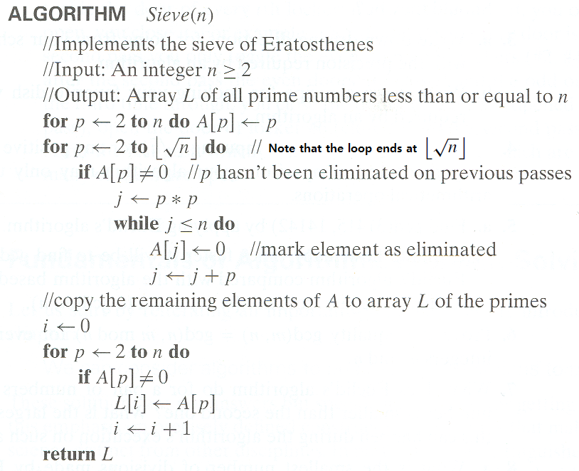
Pseudocode

Slide 30
<<< Course Instruction >>>
This week's lecture is over.
  If you do not understand any part(s), study it again.
The deadline for homework 1 is Wednesday, Jan 8 at 11:55 pm.
Next week's lecture notes (= week two) will be available on Wednesday, Jan 8, at or before 10 AM.

